Slide 1

LOAN DEFAULT PREDICTION
Name: Vinay Kiran Raju Meesaraganda
GitHub:CS668_Capstone_Project

Slide 2
To predict if the customer is good or bad to get a loan from the finance lending companies based on the odds of repayment of previous loans and demographic data of a customer to minimize the risk factor for Financial Corporations?
Research Question ?

Slide 3
Financial services plays a crucial role in country economic growth mainly by lending money. So, banks need to minimize the risk exposure by identifying high risk Customers.
Building a machine learning model to predict the loan approval of the customer will help the bank to minimize risk and maximize profits.
Data Analytics using Machine Learning is one of the rapid growing technology. This project helps me to Gain more knowledge and utilize all the skills acquired in my Masters by developing ML models & to work with analytics tools like Tableau.
Motivation ?

Slide 4
The data for the study is provided by a Digital Lending company called SUPER LENDER Located Loresho-Nairobi. The data comprises of demographic data, Performance data, Previous loans data. The data set consists of 3 different Train and Test data sets with total 35747 records and 30 attributes divided into 75:25 ratio.
The Demographic data consists of customer employment, education and bank details.
The performance data is the repeat loan that the customer has taken for which we need to predict the performance.
The Previous loan data contains all previous loans that the customer had prior to the loan above that we want to predict the performance
Data set Link: Loan Default Prediction
Data Set

Slide 5
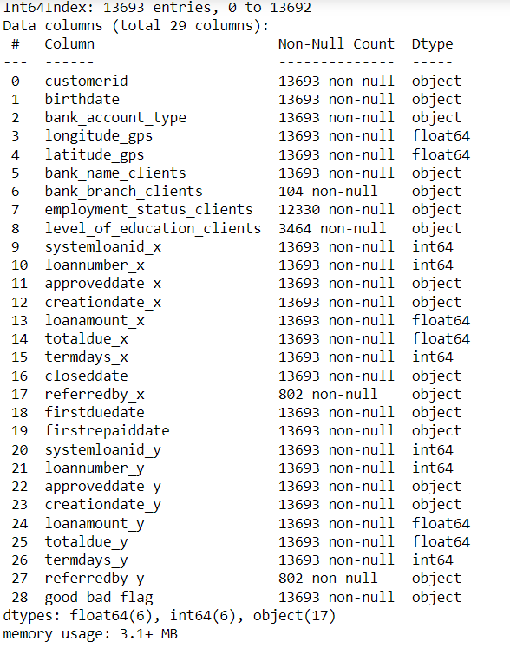
Data Set
Info

Slide 6
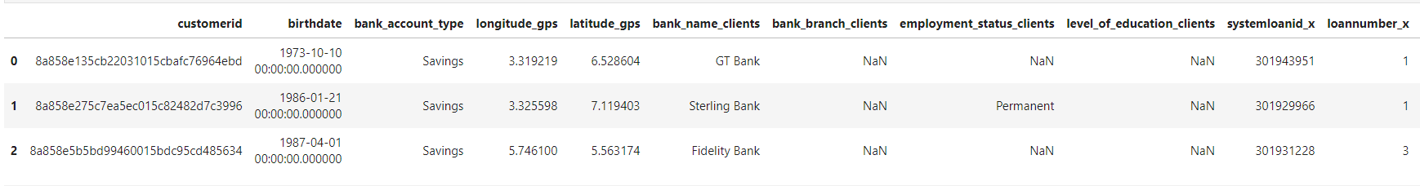
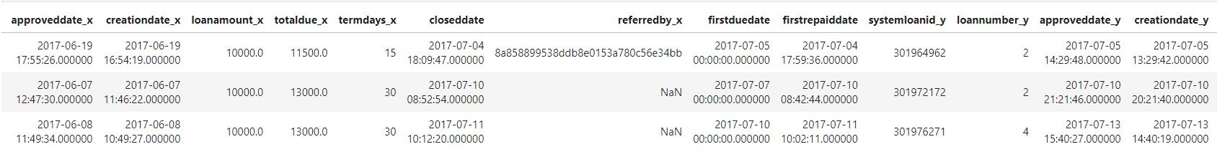
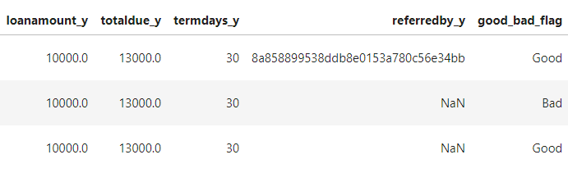
Sample Data Set

Slide 7
Literature Review
The authors in the [1] carried out systematic literature review to identify and compare the best fit ML-based models for prediction of Bank loan. The models achieved high-performance accuracy based on the precision and recall metrics, with the R.F. model achieving a 95% score.
The authors in [2] carried out KNN- model for classifying credit applicant using R package. The comparison study has been made with different levels of iterations. This technique is mainly used for industry prediction problem and applied for many classification problems. The proposed model shows 75.08% accuracy result in classifying credit applicant.
The research by [3] studied how to reduce bank’s time and to provide loans to the deserving applicants. The author used various ML models such as Decision Tree , Logistic regression to diminish the quantity of awful credit issues. In their research, [6] aims to compute the trustworthiness score to provide a reliable borrower based on LAPS (Loan Risk score, Activity score, Profile score, and Social Recommendation score). The LAPS model describes the scoring of trustworthiness that has been successfully applied to the personal lending prototype. Lenders can use the trustworthiness score to decide the eligible borrowers' candidates.
In [7], the author has used CatBoost algorithm for loan default prediction. It has achieved the highest accuracy amongst all other various algorithms. In this research Swindle implements CatBoost algorithm is used for predicting loan defaults along with a document verification module using Tesseract and Camelot and also recommends a personalized scheme for the clients.

Slide 8
Dataset
Data Pre-processing
Exploratory Data Analysis
Feature Selection
Data Splitting
Train and Test Datasets
Machine learning Model
Prediction
The information for this study was obtained from a Digital Lending company called SUPER LENDER. Data is preprocessed to enhance data quality. As well as feature choices. The data collection is split into two parts: training and testing. The machine learning model is trained using training data, and its accuracy and efficiency are assessed using testing data. The following models are implemented: random forest, Logistic Regression, XG Boost, and Decision Tree, and their performance in terms of customer loan eligibility prediction accuracy is compared. The findings provide an overview of the experimental model used to evaluate model efficiency by comparing conventional and advanced ML models to provide a comprehensive analysis of the datasets given.
Methodology
&
Workflow

Slide 9

Preliminary data preprocessing and EDA
Steps Involved in Data Processing:
Data consists of both Categorical and numeric data
Some categorical columns such as bank_branch_clients, longitude_gps, latitude_gps, creationdate_x, referredby_x, referredby_y, creationdate_y, closeddate are removed as most of them don’t affect the loan approvals.
Added a new column age from Client’s DOB
Changed some categorical columns such as firstduedate, firstrepaiddate, approveddate_x from object format to datetime format
Changed categorical column named good_bad_flag from categorical to numerical
Found some null values in columns level_of_education_clients, employment_status_clients and replaced them.
Found 20 duplicate rows in the data set and removed them.
Performed analysis on the final dataframe

Slide 10
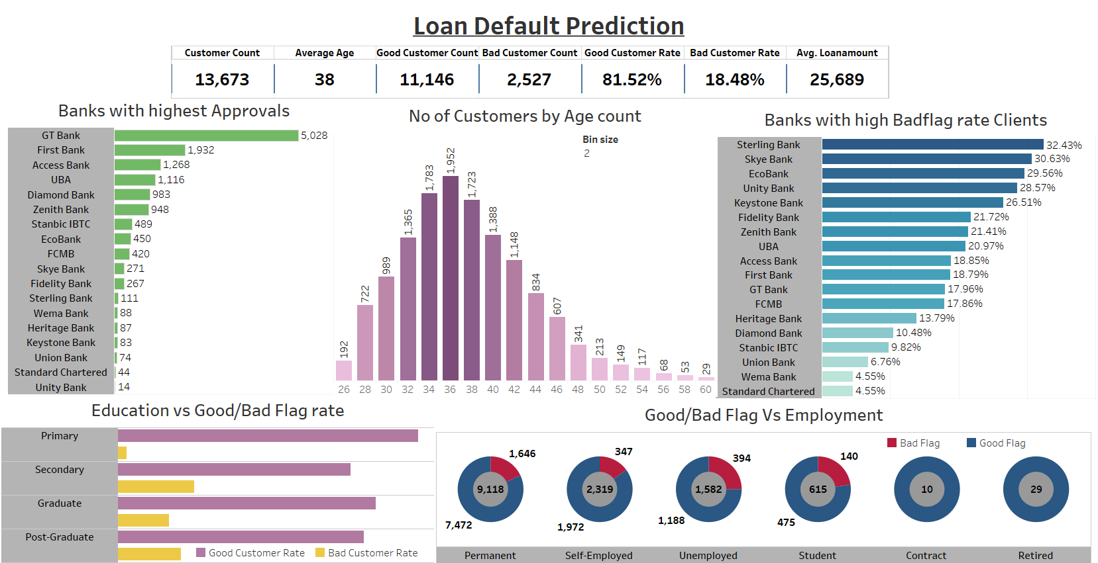
Preliminary data preprocessing and EDA
Dashboard Link : Capstone project Dashboard

Slide 11

EDA Insights
Most clients apply for loan in the age gap of 34-38.
GT Bank has the highest rate of loan Approvals
Unity Bank has the lowest rate of approvals
STERLING bank & SKYE Bank has highest rated Bad Flag Clients
Wema Bank & Standard Chartered bank has highest rated Good Flag Clients
All Contractors and Retired employment clients has high chances of loan Approvals
Unemployed has the least chances of loan approval
Clients with minimum Primary education has the highest chances
Clients with Permanent Jobs are more likely to apply loans and contractors are less likely to apply loans

Slide 12
Name | Accuracy Score | AUC Score | MAE Score
Random Forest | 92.72 | 82.69 | 7.82
Logistic Regression | 80.59 | 50.00 | 19.41
XG Boost | 93.24 | 84.51 | 6.76
Decision Tree | 95.21 | 92.17 | 4.79
Implementation Results
After analyzing all the machine learning models, it was discovered that the Decision Tree model, followed by XG Boost, had the best accuracy rate of 95.21% for forecasting customer loan eligibility. This model also received an AUC score of 92.17% and a mean absolute error rate of 4.79%. This indicates that the Decision Tree model is the most efficient and dependable model for predicting customer loan forecasts.

Slide 13
Thank You

